Slide 1
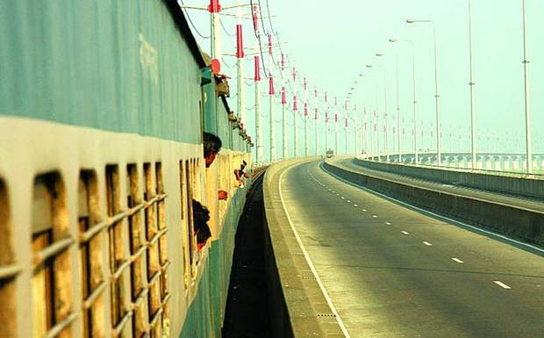
TRAIN TICKET MANAGEMENT

Slide 2
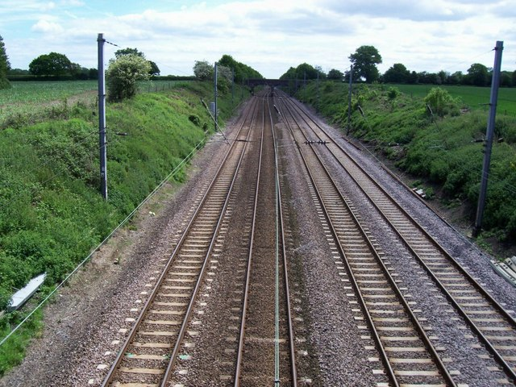
Introduction
AHMED NOKIB MOJUMDAR
-13101018
SABBIR AHMED
-13101024
RUHUL AMIN
-13101009

Slide 3
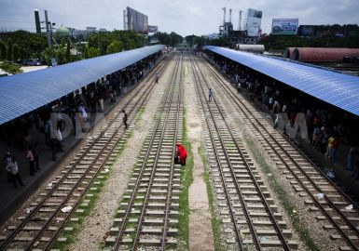
Slide Content
Features of our project
Application
Equipments
Flow chart
Motivation
Conclusion

Slide 4
Features of our project
FILE SYSTEM
Train name
Train list
Passenger list
Arrive time
Departure time
Ticket availability
GRAPHICS.H
Circle
Line
Get fill
System colour

Slide 5
Application
File system
We can use this file project for many kinds of purposes .Mainly for the railway ticket booking system . Here is the application of this project.
♣ Ticket booking
♣ Ticket counter system
♣ To make the ticket counter system dynamic
♣ To reduce the crowd in railway counter

Slide 6
Application
Graphics.h
Our main purpose behind this graphics work is just for fan. Doing this work is interesting .
♣ Football field
♣ It can also be use for foosball game

Slide 7
Equipments
♣ CodeBlocks IDE
♣ Text document
♣ Dev c++
♣ Graphics.h
♣ Windows.h
♣ Website link

Slide 8
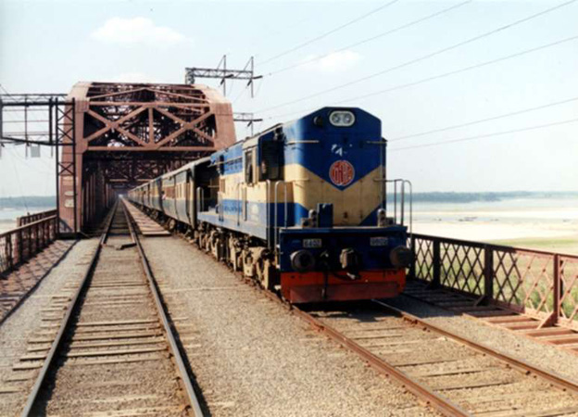
Flow Chart
START
STRUCTURE 1
&
STUCTURE2
LOADING DATA FROM FILE
YES
NO
USER INPUT
TICKET AVAILABLE
GET YOUR BOOK
END

Slide 9
Motivation of our project
We have a future plan to enlarge our work field .
We will try to include the routs of railway . More passenger management system .
In graphics.h our plan is to make it a complete game .

Slide 10
Conclusion
Special thanks goes to
◘ Md. Asif Hossain
◘Majharul Islam Jihan
◘Sayed Lipu
◘Online link
Because we found them helpful while
we faced any problem creating this project .We also follow some ideas from their code .

Slide 11
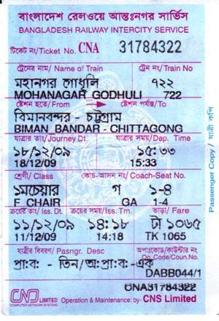
THANK YOU

